Slide 1

Programming 2 LAB
TA: Nouf Al-Harbi
NoufNaief.net ::: nouf200@hotmail.com

Slide 2
Lab Materials
NoufNaief.net

Slide 3
NetBeans & JDK Setup
Installing JDK-7 windows ➔
http://www.oracle.com/technetwork/java/javase/downloads/java-se-jdk-7-download-432154.html
Installing NetBeans7.2 Java SE ➔
http://netbeans.org/downloads/
Detailed steps of installation are uploaded at the website

Slide 4
Lab 1
The Account Class

Slide 5
The Account Class
Problem Description:
(The Account class) Design a class named Account that contains:
A private int data field named id for the account (default 0).
A private double data field named balance for the account (default 0).
A private double data field named annualInterestRate that stores the current interest rate (default 0). Assume all accounts have the same interest rate.
A private Date data field named dateCreated that stores the date when the account was created.
A no-arg constructor that creates a default account.
A constructor that creates an account with the specified id and initial balance.

Slide 6
The Account Class
Problem Description (contd.) :
The accessor and mutator methods for id, balance, and annualInterestRate.
The accessor method for dateCreated.
A method named getMonthlyInterestRate() that returns the monthly interest rate.
A method named withdraw that withdraws a specified amount from the account.
A method named deposit that deposits a specified amount to the account.

Slide 7
The Account Class
Draw the UML diagram for the class. Implement the class. Write a test program that creates an Account object with an account ID of 1122, a balance of $20,000, and an annual interest rate of 4.5%. Use the withdraw method to withdraw $2,500, use the deposit method to deposit $3,000, and print the balance, the monthly interest, and the date when this account was created.

Slide 8
Solution..

Slide 9
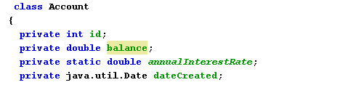
Account Class – Data Fields

Slide 10
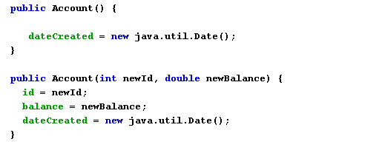
Account Class – Constructors Methods

Slide 11
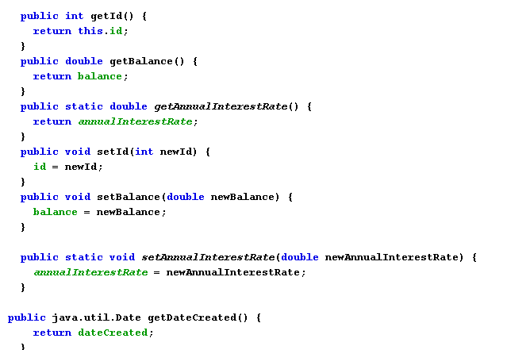
Account Class – Accessor & Mutator Methods

Slide 12
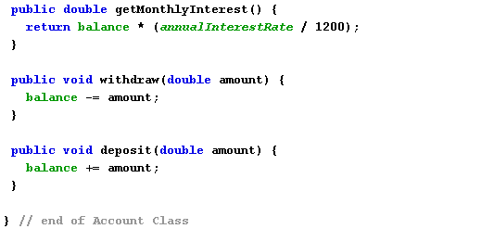
Account Class – Methods

Slide 13
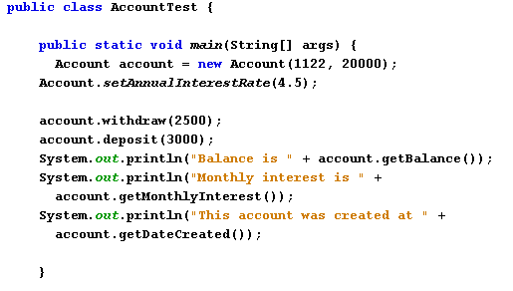
Account Class – Test Class

Slide 14
End of Lab 1

